Slide 1

Air France
BUSINESS CASE
Team 4
Hult International Business School MBAN

Slide 2



Our Strategy:
Searching for the optimum SEM campaign
Choose the efficient distribution of advertising budgets
Choose pertinent keywords and bid techniques

Slide 3
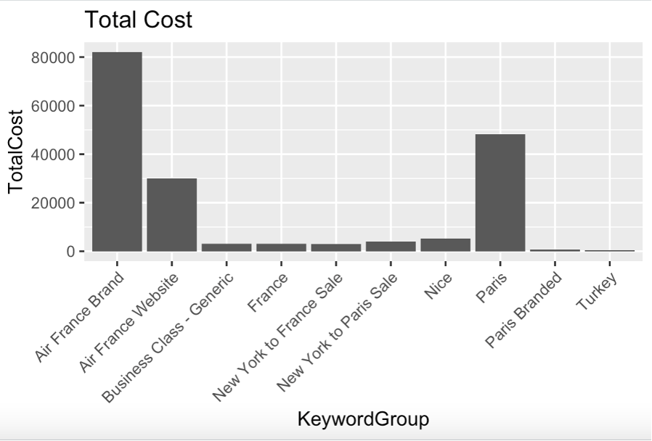
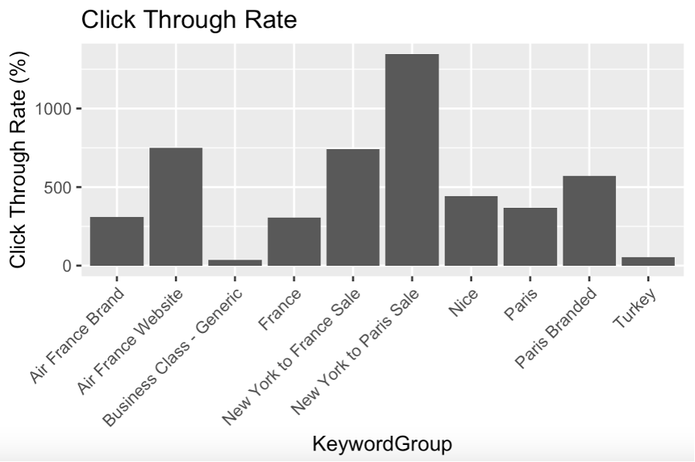
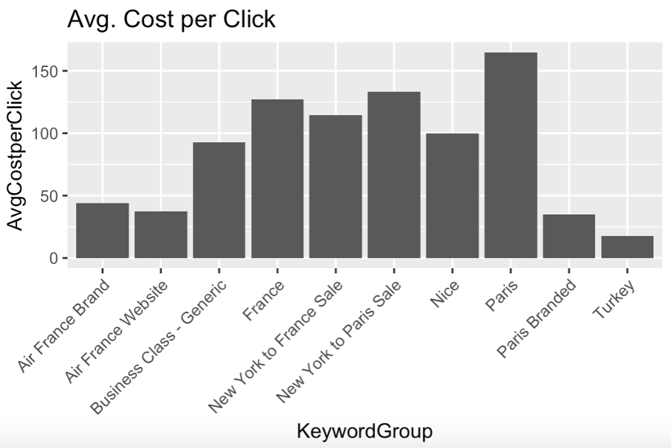

Keyword Performance

Slide 4
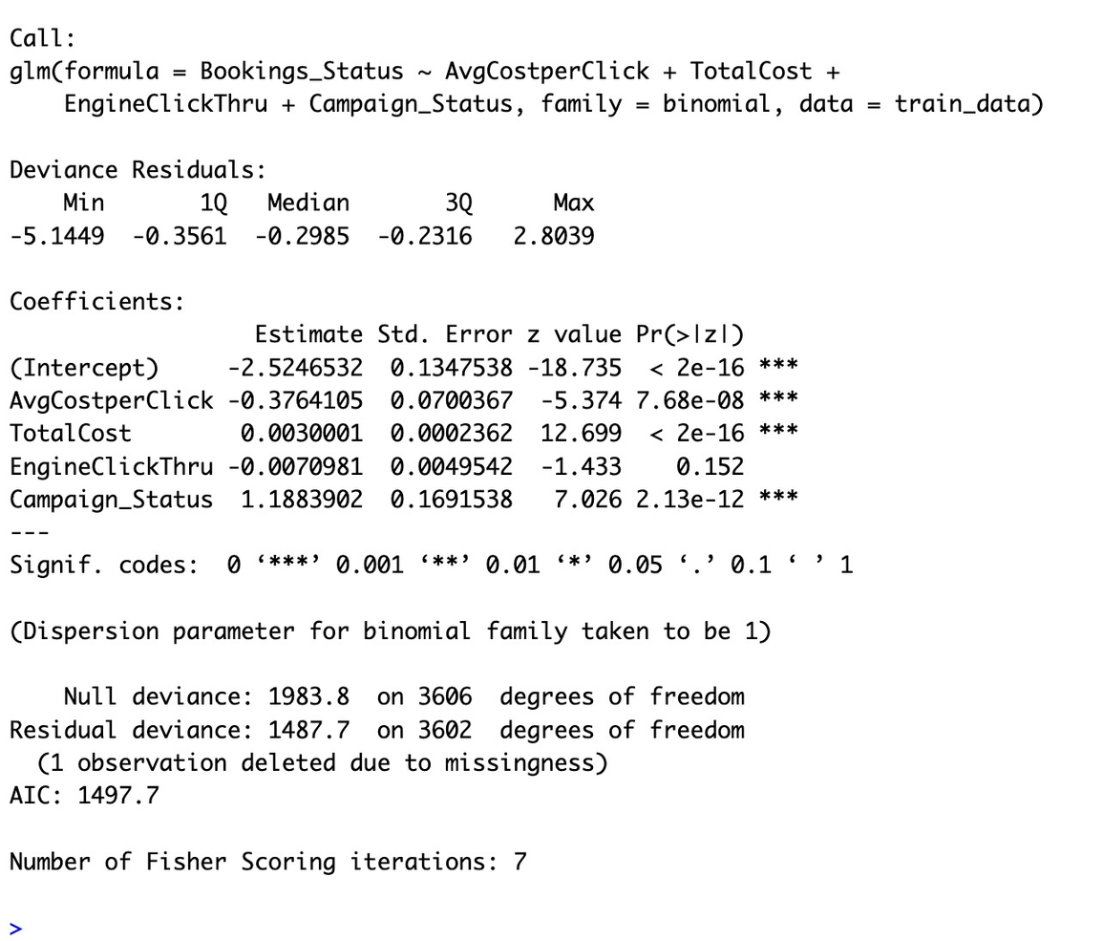
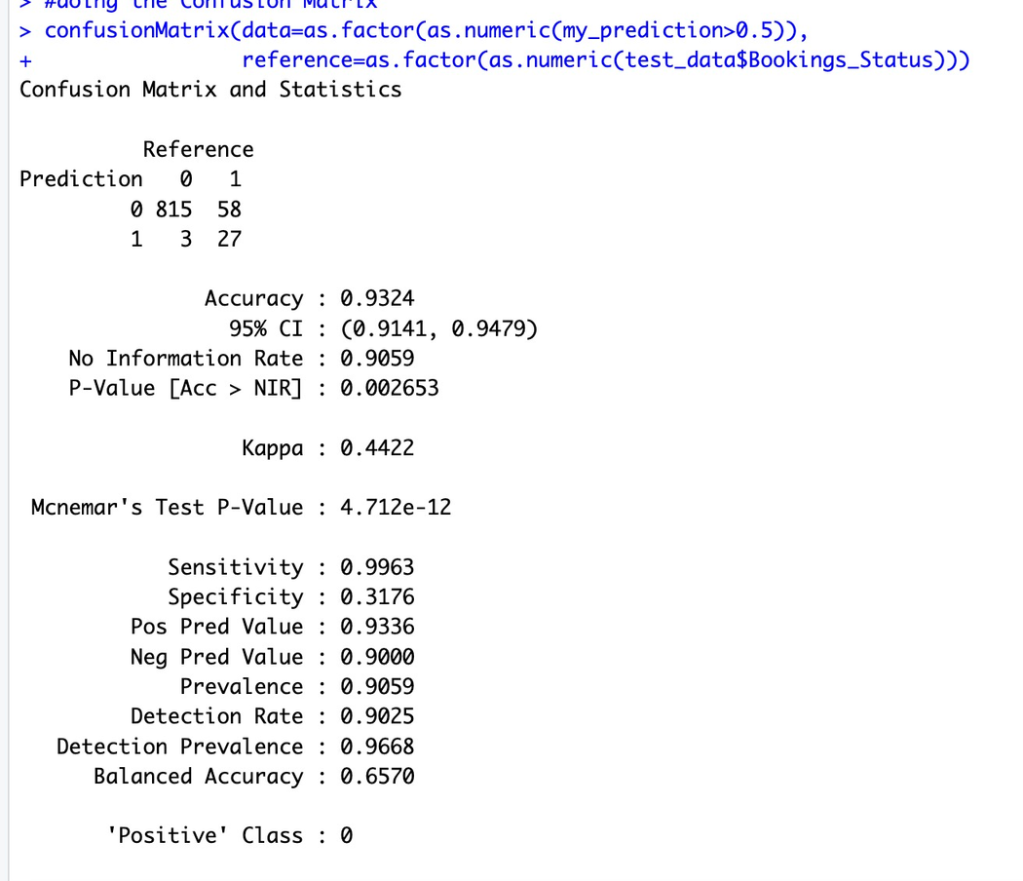
Logistic Model Analysis

Slide 5
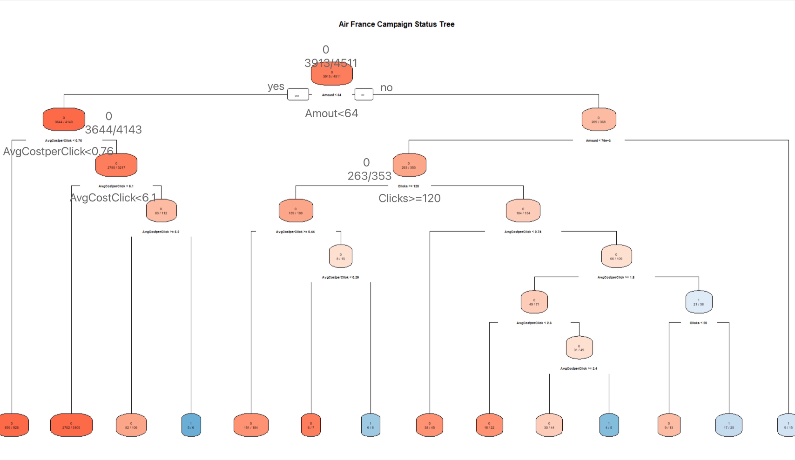
Decision Tree Analysis

Slide 6
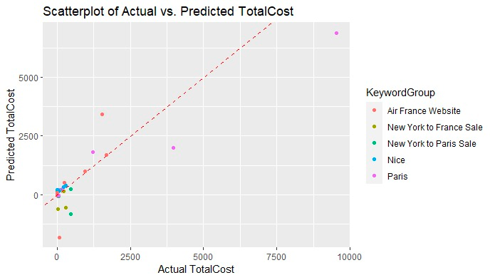
Scatterplot Analysis

Slide 7




Recommendation
Target a less competitive audience
Optimize the keywords and targeting
Optimize the ad copy and landing pages
Track the results of the campaigns and make adjustments as needed

Slide 8

Thank you!
BUSINESS CASE
Team 4
Hult International Business School MBAN

